Slide 1

Predicting Urban Growth: A Data-Driven Approach
This presentation explores the development and application of a prediction model for urban built-up areas, utilizing remote sensing and GIS technologies to forecast future growth trends.

Slide 2

Understanding Urban Growth
Rapid Expansion
Challenges
Urban areas are expanding at an unprecedented rate, driven by population growth, economic development, and technological advancements.
This rapid growth brings numerous challenges, including resource scarcity, infrastructure strain, and environmental concerns.

Slide 3
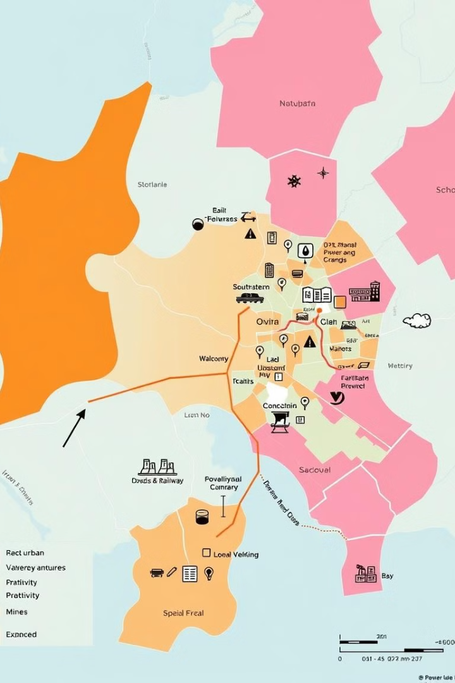
Factors Driving Urban Growth
Economic Opportunities
Infrastructure
Job prospects, investments, and business activities attract people to urban centers.
Transportation, communication, and other infrastructure play a role in shaping urban growth patterns.
Demographics
Environmental Factors
Population growth and migration trends significantly impact urban expansion.
Proximity to water bodies, fertile land, and other natural resources influence urban growth.

Slide 4
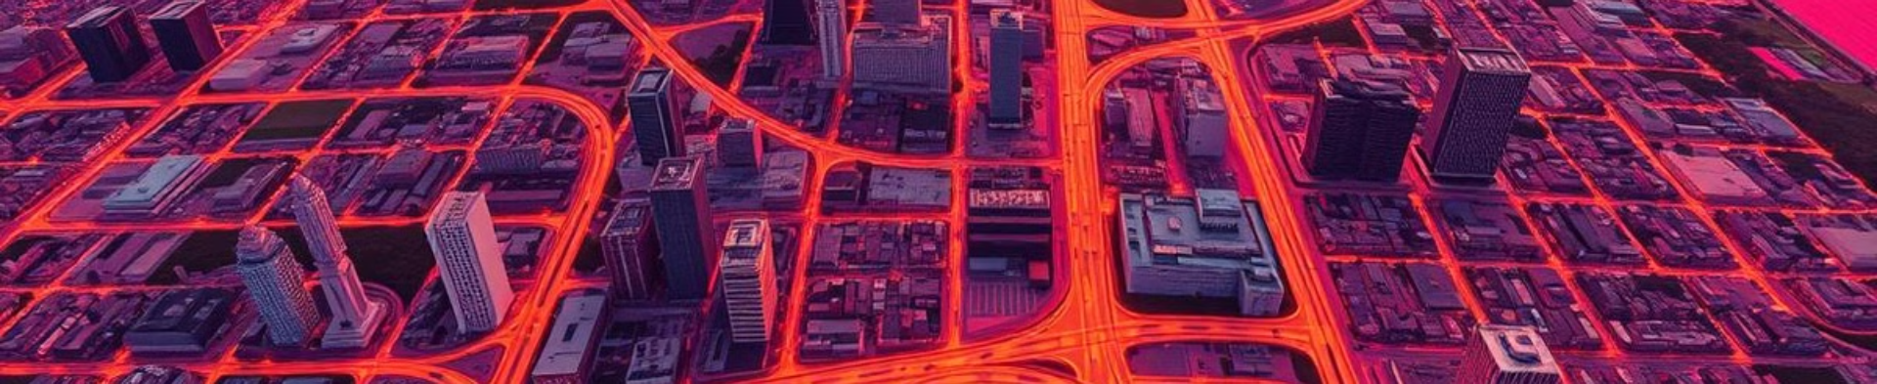


Remote Sensing and GIS for Urban Monitoring
Satellite Imagery
GIS Analysis
Satellite images provide high-resolution data about land cover, urban features, and changes over time.
Geographic Information Systems (GIS) tools analyze and visualize spatial data to understand urban patterns.

Slide 5

Principles of Urban Growth Prediction Models
1
Statistical Analysis
2
Regression Models
Historical data and trends are analyzed to identify patterns and relationships.
Mathematical models predict future values based on historical data and influencing factors.
3
Scenario Analysis
Different scenarios, such as population growth and economic changes, are considered to assess potential future outcomes.

Slide 6
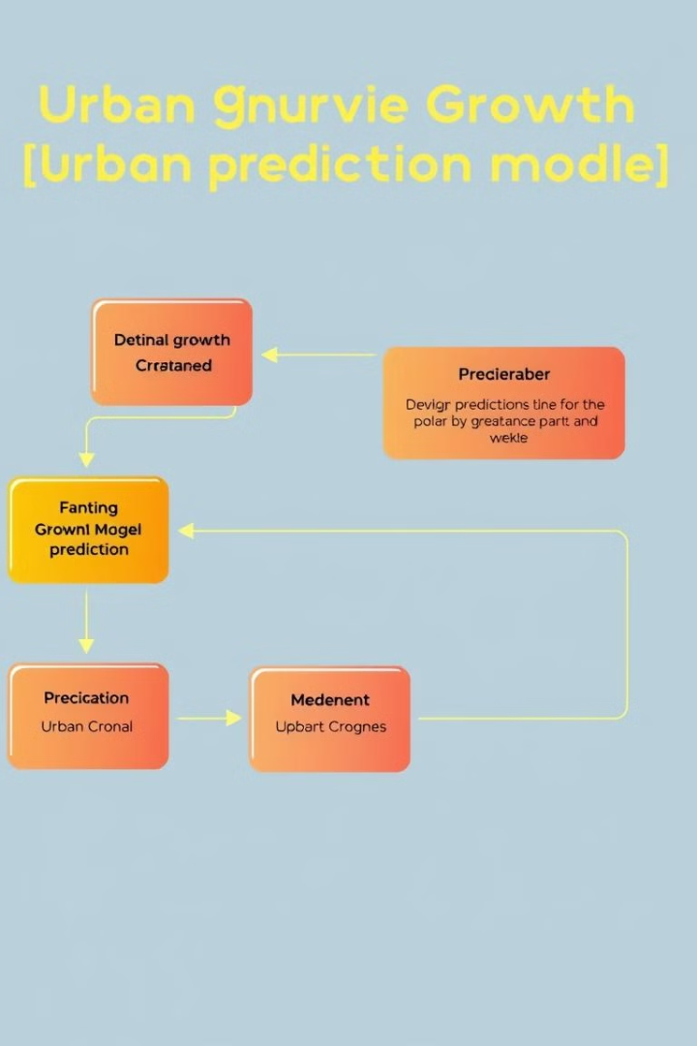




Developing the Prediction Model Framework
Data Acquisition
Gather historical urban data, including land cover, population, and economic indicators.
Model Selection
Choose a statistical model that best fits the characteristics of the data and research objectives.
Model Calibration
Adjust model parameters to ensure accurate predictions based on the collected data.
Model Validation
Evaluate the model's accuracy by comparing predictions with actual urban growth patterns.

Slide 7




Case Study: Applying the Model
1
Case Study Area
2
Model Implementation
3
Results and Analysis
4
Policy Implications

Slide 8

Conclusion and Future Directions
1
2
Model Accuracy
Future Research
The model accurately predicted urban expansion patterns.
Integrate more data sources and advanced machine learning techniques.

